Slide 1
Erasmus+ survey findings
Aineiston keruu: Tammikuu – Kesäkuu 2017
Eurooppalaiset lukiolaiset (n=144)
Italia (n=31)
Tsekki (n=30)
Puola (n=28)
Suomi (n=26)
Saksa (n=22)
Espanja (n=7)

Slide 2
Sleep

Slide 3
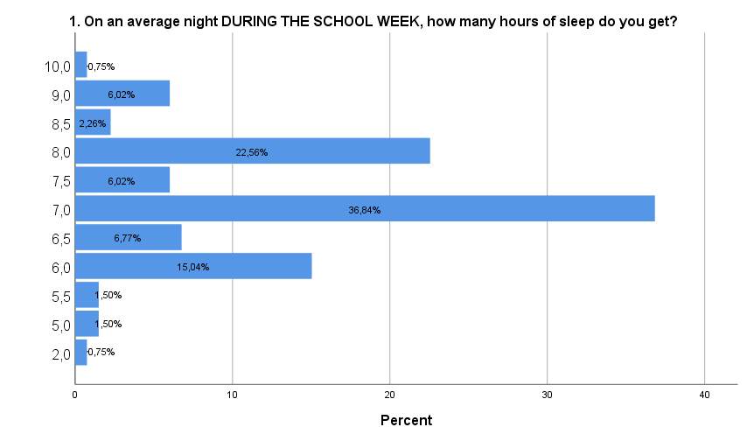

Slide 4
WASHINGTON, DC, ( February 2, 2015)-- The National Sleep Foundation (NSF)
Newborns (0-3 months): Sleep range narrowed to 14-17 hours each day (previously it was 12-18)
Infants (4-11 months): Sleep range widened two hours to 12-15 hours (previously it was 14-15)
Toddlers (1-2 years): Sleep range widened by one hour to 11-14 hours (previously it was 12-14)
Preschoolers (3-5): Sleep range widened by one hour to 10-13 hours (previously it was 11-13)
School age children (6-13): Sleep range widened by one hour to 9-11 hours (previously it was 10-11)
Teenagers (14-17): Sleep range widened by one hour to 8-10 hours (previously it was 8.5-9.5)
Younger adults (18-25): Sleep range is 7-9 hours (new age category)
Adults (26-64): Sleep range did not change and remains 7-9 hours
Older adults (65+): Sleep range is 7-8 hours (new age category)

Slide 8
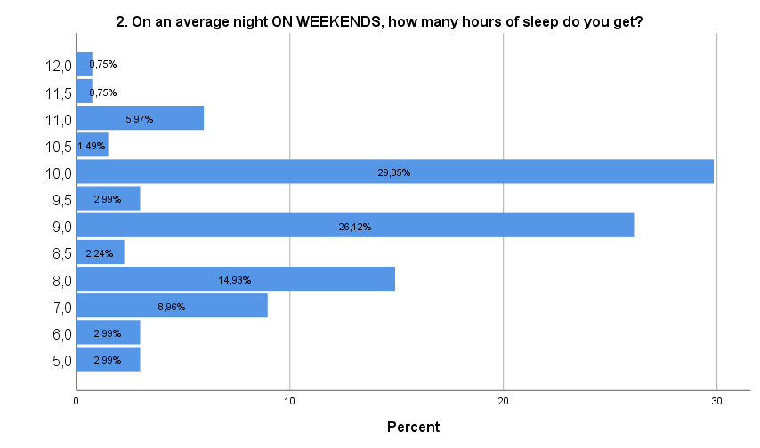
41,8%
35,11

Slide 9
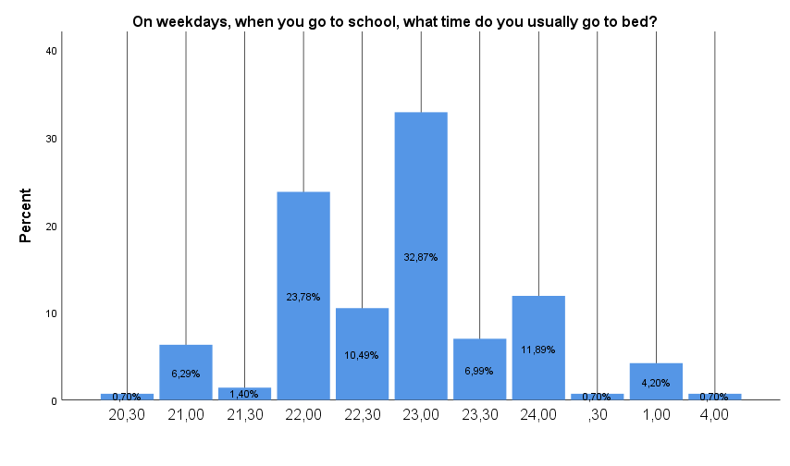
5,6%

Slide 10
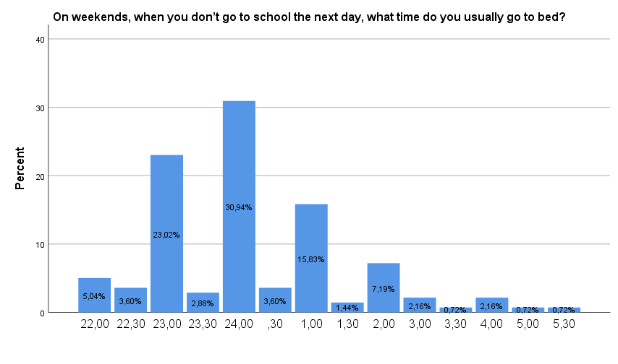
34,5%

Slide 11
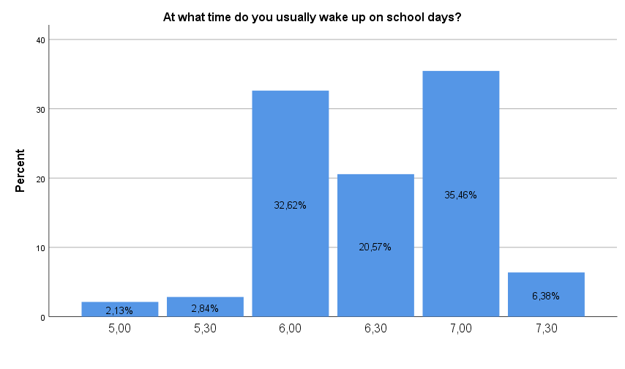

Slide 12
Nutrition

Slide 19
Physical activity

Slide 20
UKK-instituutin 13-18 vuotiaiden liikuntasuositus:
Liiku vähintään 1 ½ h vuorokaudessa – puolet siitä reippaasti!
Nosta sykettä ja hengästy joka päivä!
(reipas kävely, hölkkä. pyöräily, uinti, hiihto)
Kuormita lihaksia 3 krt/vko!
(tanssi, pallopelit, kuntosali)
Liiku aina kun voit!
(välitunnilla, käytä portaita, kulje kävellen/pyörällä, vältä istumista)

Slide 22
Social relationships

Slide 27
Schoolwork

Slide 31
General health

Slide 33
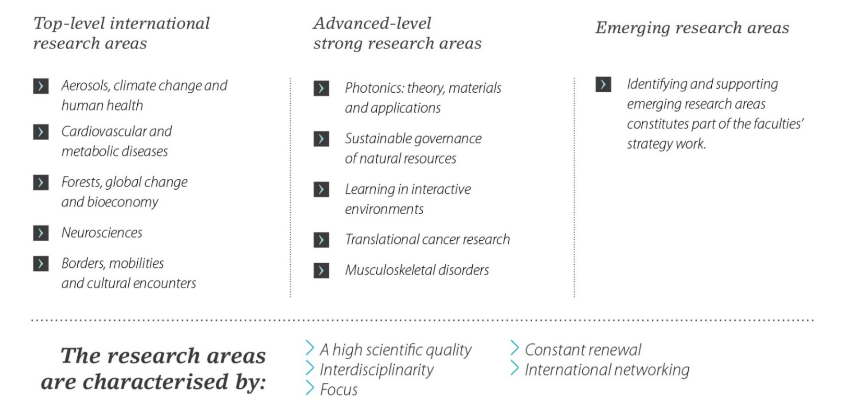
Thank you!
Marjorita Sormunen
University of Eastern Finland
Department of Nursing Science
POBox 1627, 70211 Kuopio
marjorita.sormunen@uef.fi
Photos with permission of study schools’ pupils

